Slide 1

Pathway powered conversational Agent for IIT Indore
Indian Institute of Technology, Indore
01-08-2025
Mentored by - Anurag

Slide 2
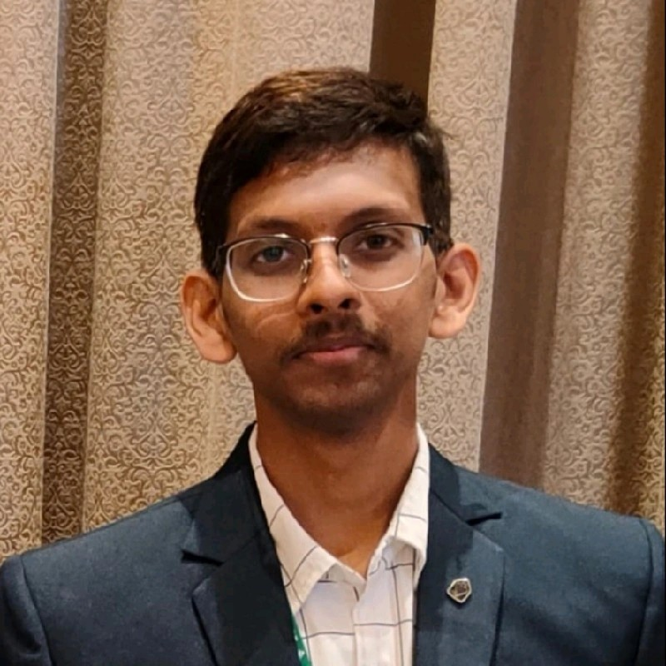






Meet the Team
Indian Institute of Technology, Indore
01-08-2025
Teja Nikhil
MS CSE
Saransh Vashistha
MS CSE
Ayush Kumar Singh
MS CSE
Mohd Aamir
MTech CSE
Ankit Kayastha
MTech CSE
Jatin Sharma
MS CSE

Slide 3
Let's Explore
Indian Institute of Technology, Indore
01-08-2025
01
03
Methodology
Critical Challenges
05
End to end pipeline design we have designed to build the chatbot.
Deep dive into the challenges we faced while implementation and how we solved it.
Problem Statement
Our Process
Outcome
02
Deep dive into the implementation and the tools used and initial plan for building the chatbot.
04
The problem statement that we dealt with.
Evaluation metrics and the demo of the chatbot along with the logs.

Slide 4
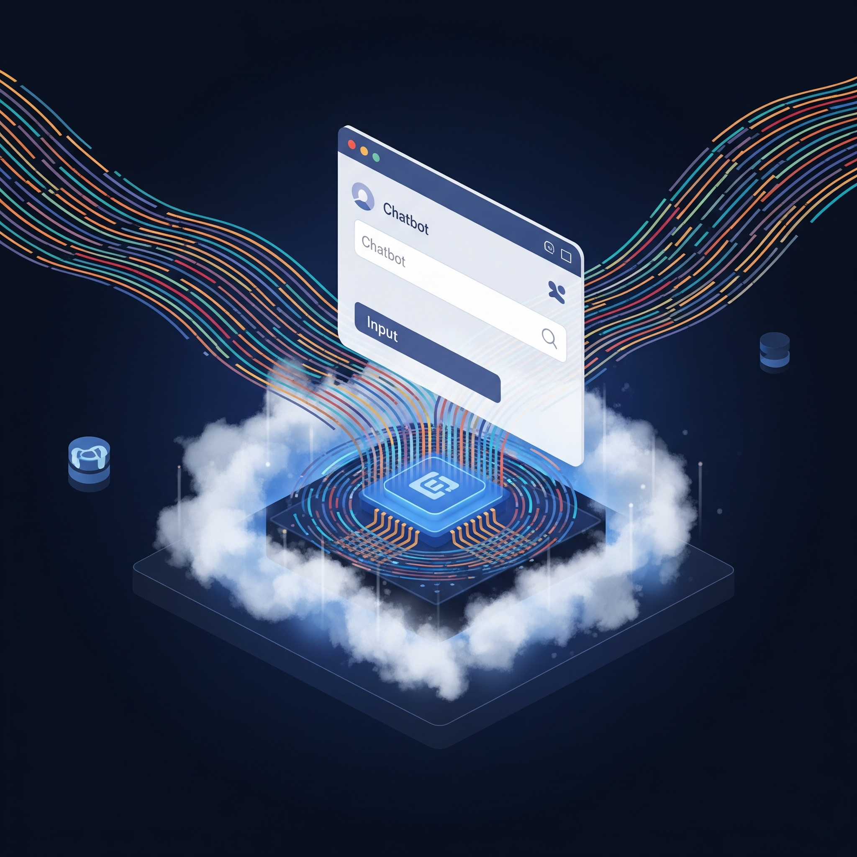
Problem Statement
Indian Institute of Technology, Indore
01-08-2025
Statement
Build a conversational agent for our institute using RAG
Objective
Autonomously answer the queries related to IIT indore.
Capabilities
Real time streaming, Multi-Hop reasoning, interactive, scalable
Tools
Mandatory use of pathway, Agentic RAG design

Slide 5
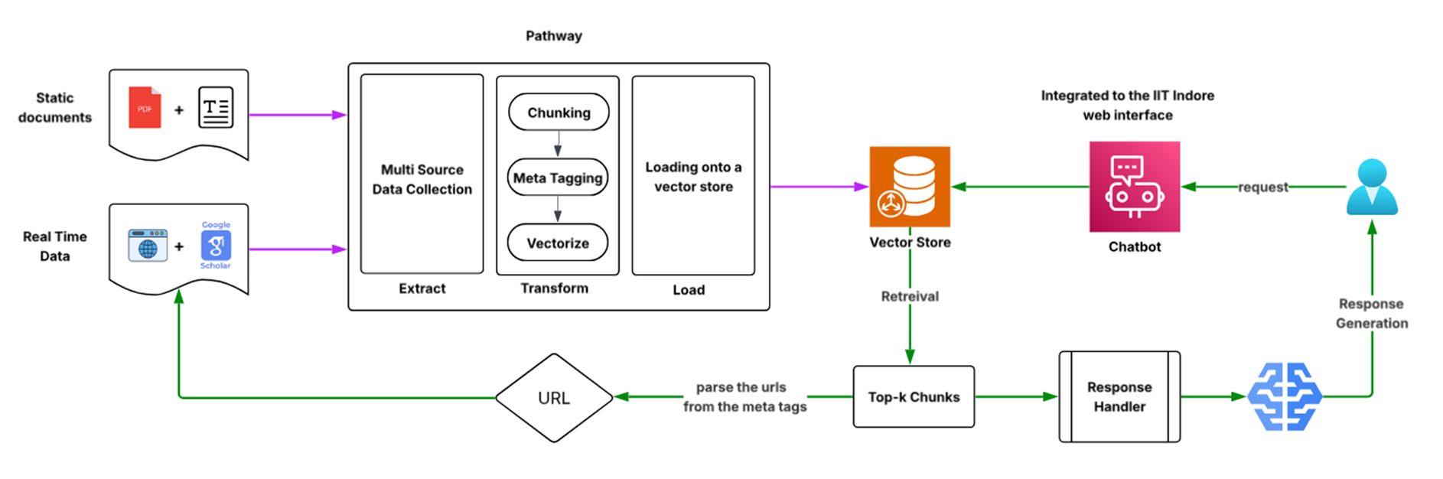
Methodology
Indian Institute of Technology, Indore
01-08-2025
Fig : Proposed RAG design with Pathway

Slide 6
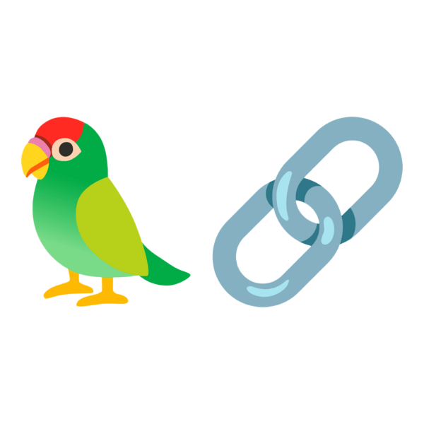
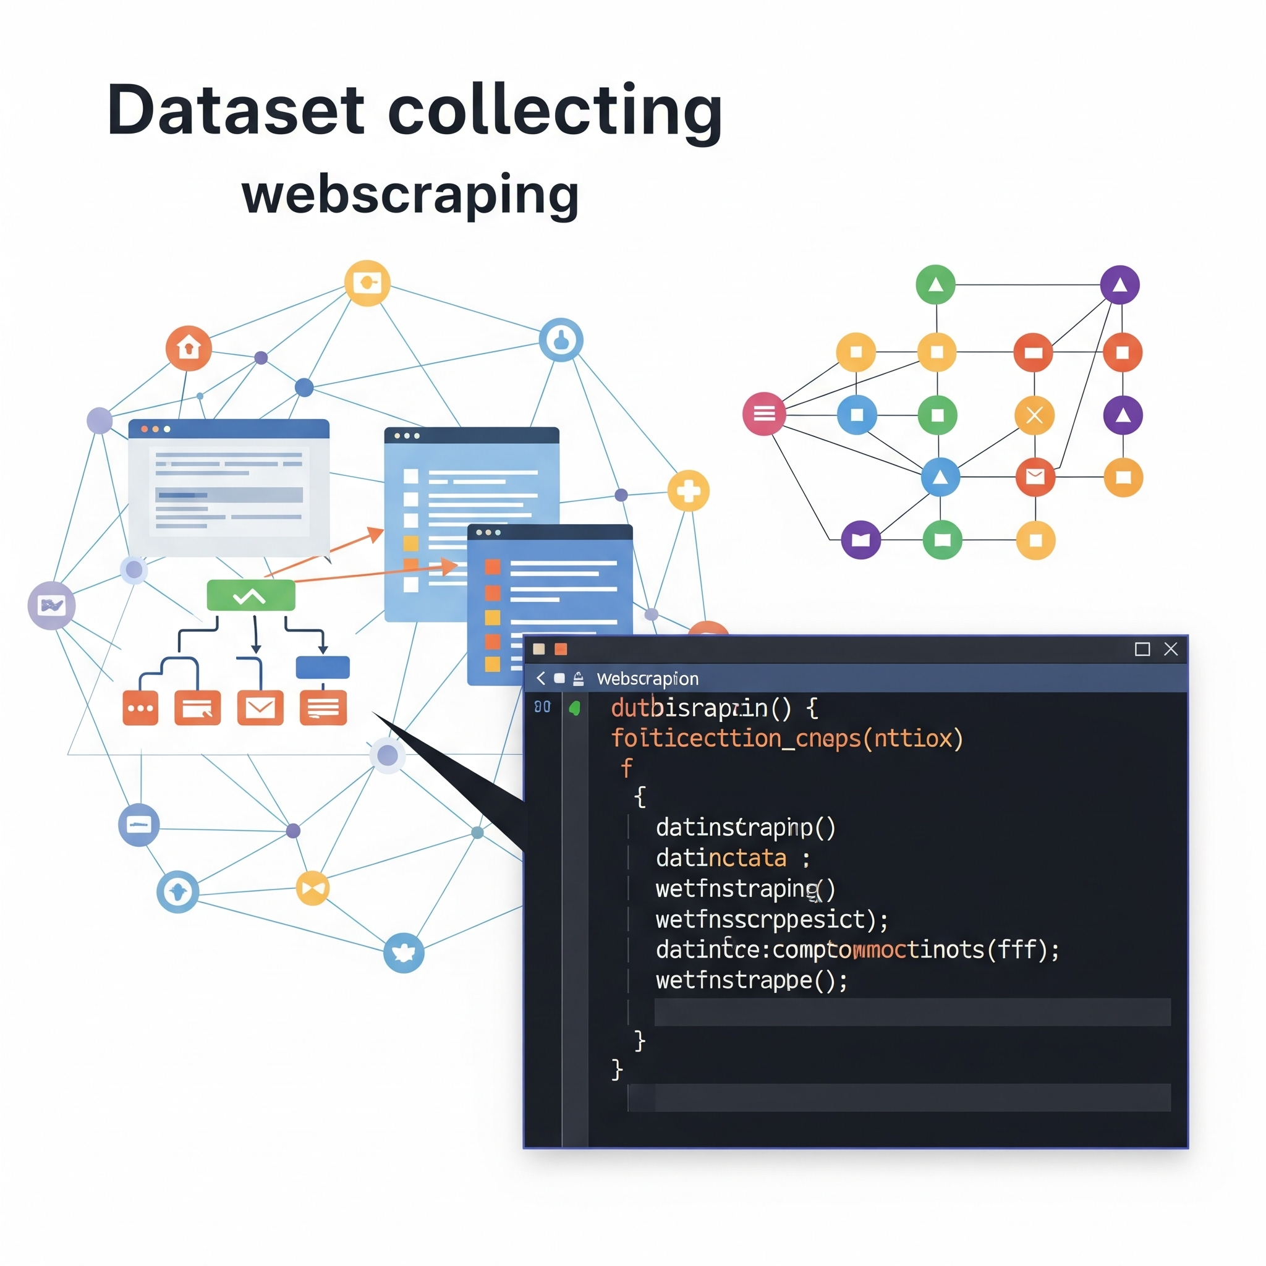




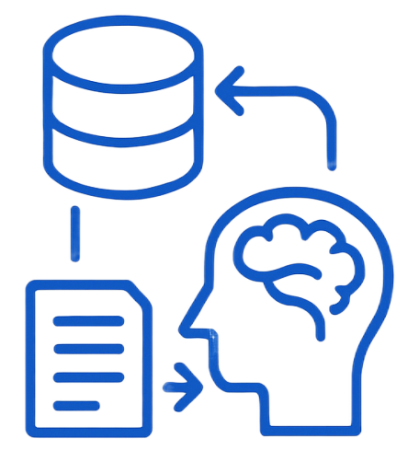



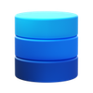
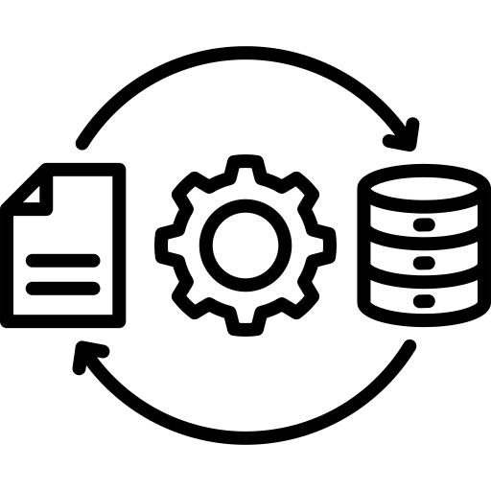
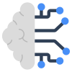

Indian Institute of Technology, Indore
01-08-2025
Dataset Collection
Extract - Transform - Load (ETL) Framework
Tools Used : Selenium, BeautifulSoup
Transformation includes :
- Document OCR
- Ensuring Coherence
- Data Cleaning
- Keyword extraction
Document Chunking :
- Splitting chunks based on word count
- Created overlapped chunks
Vector Store :
- PathwayVectorClient by Langchain
Data Sources : HTML, PDFs, Text.
Organization : Semantic Clusters

Slide 7

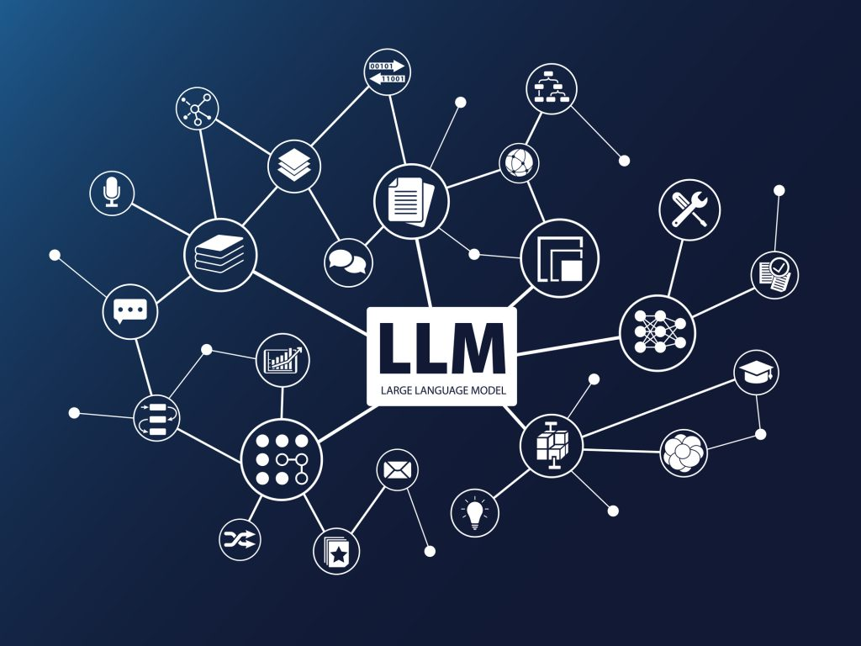


Indian Institute of Technology, Indore
01-08-2025
Concurrency
Language Models
Application Layer
Used Multi-threading for fast processing
At the deployment stage we used :
1. Batch processing for improving throughput
2. KV-Cache for improving latency
LLMs are used as a summarization tool
Rest APIs are created used FLASK.
Supports multi-user inputs using sessions
Used redis as in-memory database.
Used ConversationBufferMemory by Langchain for storing previous chats.
It serves two purposes :
1. Data preparation
2. Response generation
Tools Used : Hugging face, OLLAMA
Tools Used : Hugging face, OLLAMA

Slide 8
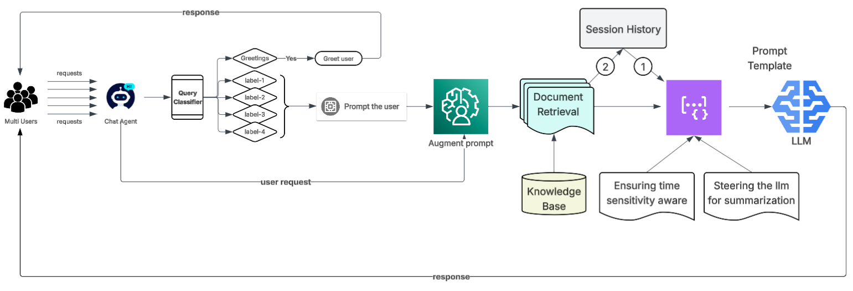
Indian Institute of Technology, Indore
01-08-2025
Journey of Request to Response
Fig : Proposed pipeline design for the chatbot

Slide 9

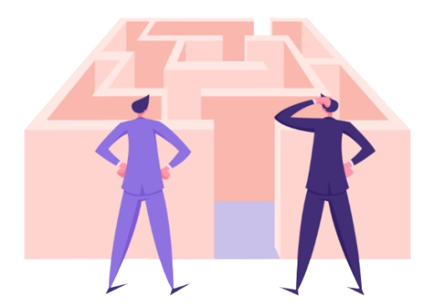




Critical Challenges
Indian Institute of Technology, Indore
01-08-2025
Limitations with computational power
Data collection and format specific preprocessing
Dilution of data because of LLMs intervention
Dynamic updation of web data with RAG knowledge base
Making the chatbot multi-hop and interactive

Slide 10
Indian Institute of Technology, Indore
01-08-2025

Slide 11
Indian Institute of Technology, Indore
01-08-2025

